Slide 1
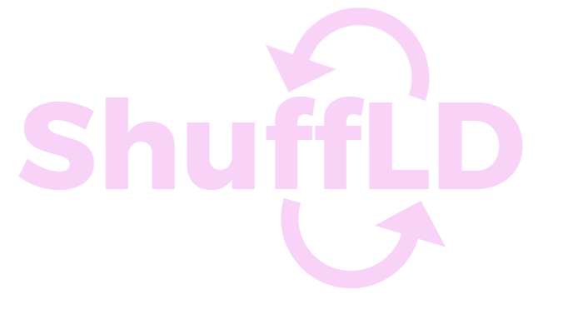
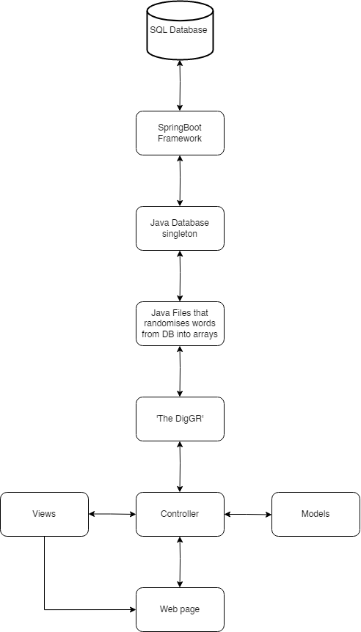
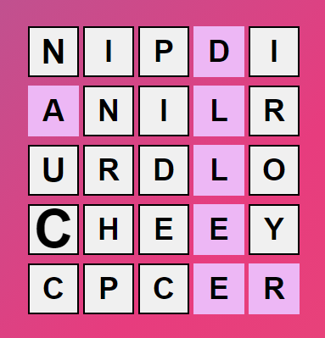
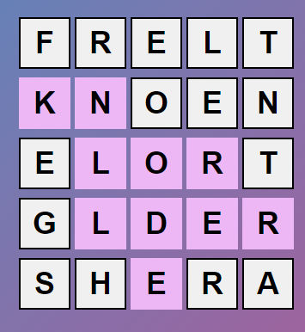
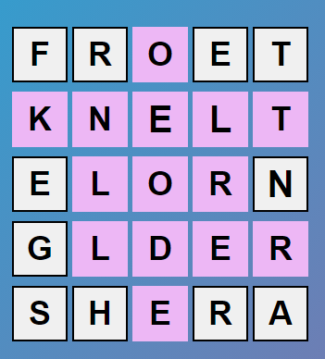
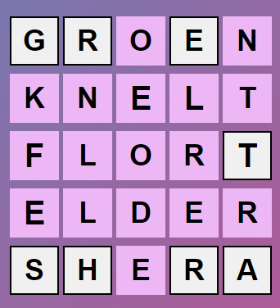
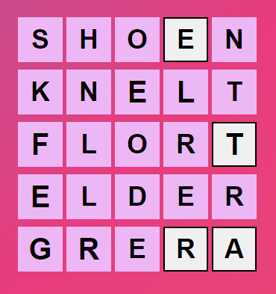
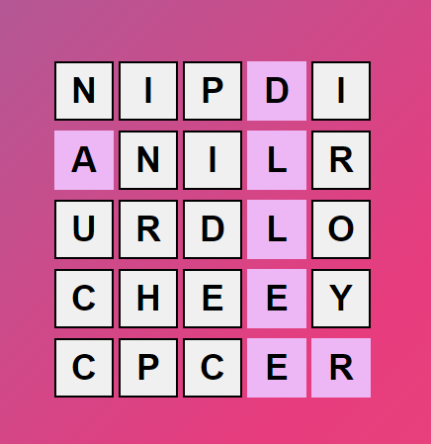

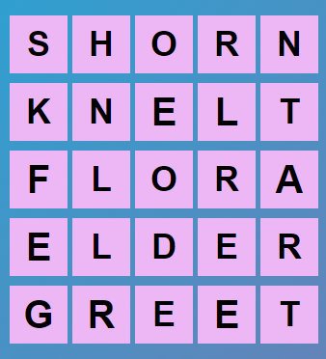
How it’s made:
Made via Spring Boot (java framework)
MySQL Database
Java connects to the database and retrieves 5 random words
Uses HTML CSS, and JavaScript to display the grid, and moves left counter.
HTML sets up the base of the page, which will be requested from the view in the Spring Boot application
JavaScript used to create all the legal moves for our game, and all the winning and loss conditions also locking correct moves into place
CSS used for styling and colour changes for visual aid, so the user knows correct and incorrect letters.
A Web-based game, challenging the brain to find the 5 words that are ‘ShuffLD’
The Game Itself:
Everyone’s grid is ‘ShuffLD’ differently
What is it:
A word game that challenges the user to solve the scrambled words within 20 moves
Player only has one attempt a day. The shuffled words will be refreshed daily, keeping the users brain stimulated and wanting to play more.
Every day the player will always be challenged, against the difficult bot, ‘The DigGR’
From here, the game is completed, as all the letters are pink meaning they are in the correct spot.
How ‘ The DigGR’ is made:
The bot can only be as smart as its creator, right? Maybe not
Created via Java, using the ‘Conquer and Divide’ to make the most efficient swaps
Uses data structures to store letters that are deemed unworthy to swap, or are against the rule set.
Makes swaps based on the premise that the letter to swap seems most logical.
‘ The DigGR’
Everyone is talking about it. It’s Taking over ShuffLD. Somehow can complete the game in as least moves as possible.
You are against it. Can you beat it? It averages 13-15 moves everyday.

